Slide 2
ACP & DCP
THE ARRANGER AND DIRECTOR CERTIFICATION PROGRAMS

Slide 3
Jeanne Elmuccio, PMP, CRISC
musicpoodle945@verizon.net (908) 477-7775
Graduate of the Brooklyn Conservatory of Music
Director of Music, Calvary Lutheran Church, Cranford
Sweet Adelines International
Certified Director
ACP Task Force
ACP Committee (Administrator)
Approved Arranger
https://aeolianje.wixsite.com/website
Region 15
Regional Faculty
Directors Coordinator
Regional ACP Coordinator
DCP Coordinator
Director, Heart of NJ Chorus
Asst Director, Liberty Oak
Quartet and chorus coaching

Slide 4
Becky Woodard
DCP Coordinator
Certified Director
Assistant Director, Heart of NJ Chorus
Board President, Heart of NJ Chorus
Becky’s Bees
Email: beckstersings@aol.com
Sonny Steffan
Approved Arranger
Administers the Region 15 Arrange-by-Email Program
Region 15 ACP Coordinator
Retired chorus director
Email: soniasteffan9@gmail.com

Slide 6
Arranger Certification Program (ACP)
educational program
develop skills for SAI:
potential arrangers
directors
quartet members
musical leaders
understanding of how to analyze and arrange music in the barbershop style.

Slide 7
The program is broken into three skill levels:
Beginner, Intermediate and Advanced
Beginner Level:
Self-study with testing based on the current SA Arranger’s Guide and supplemental materials to be provided by the program.
9 modules

Slide 8
Module 1 Music Theory for Arrangers
Module 2 The Music Category – Defining the BBS Style
Module 3 Voicings and Overtone Patterns
Module 4 Harmonization
Module 5 Starting to Arrange: Song Selection, Transposition, Manuscript
Module 6 Voice Leading
Module 7 Embellishments
Module 8 Arrangement Analysis
Module 9 The Business of Arranging (Copyright Law)

Slide 9
Beginner Level:
Module 1 is reciprocal with the Music Theory Module in the DCP Program, so if you have passed that DCP Module with at least 80%, you will receive credit for it in the ACP and will not need to retake the test.
Modules 1, 3, 4, 5, 6, 7, and 8 must be taken in order and the test for each must be passed with at least 80%, in order to take the next test.
Modules 2 (Music Category) and 9 (Copyright Law), which also must be passed with at least 80%, may be taken at any time.

Slide 10
Beginner Level:
If you have some background in arranging, you may choose to “Challenge” the Beginning Level Modules.
This involves taking the tests for Modules 2, 8, and 9, passing each with at least 80%.
Notify your Regional ACP Coordinator or Regional Education Coordinator if you wish to do so.
All modules provide a Sample Test to help you assess your understanding of the topic and prepare for the Final Test.
Participants who successfully complete the Beginner level will receive a certificate from SAI.

Slide 11
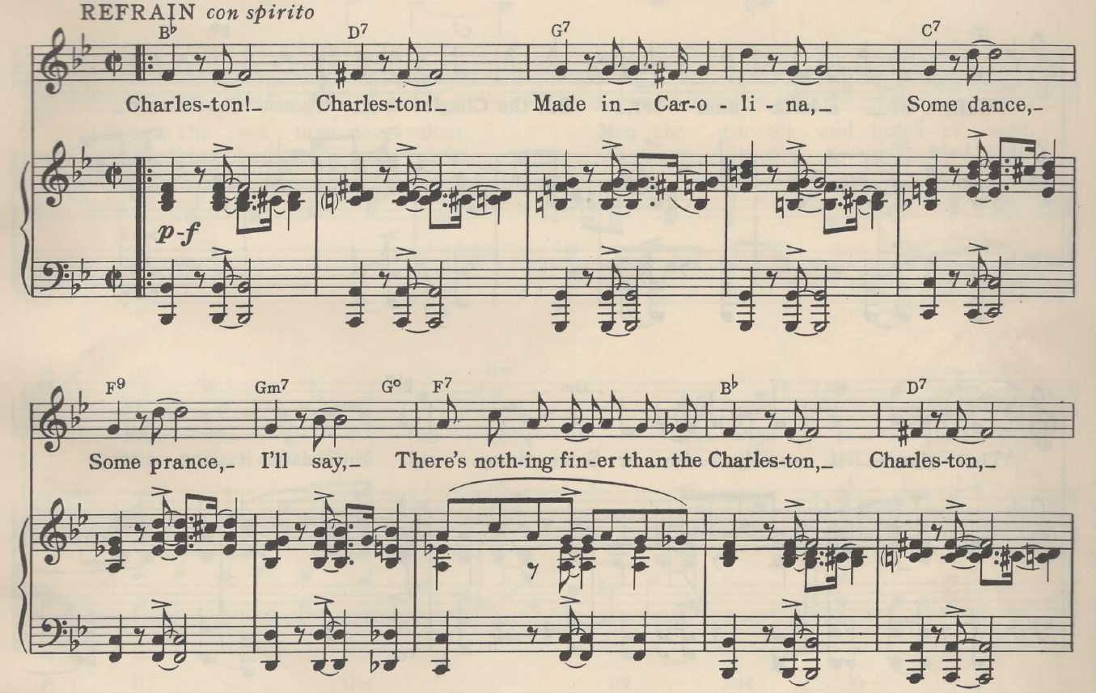
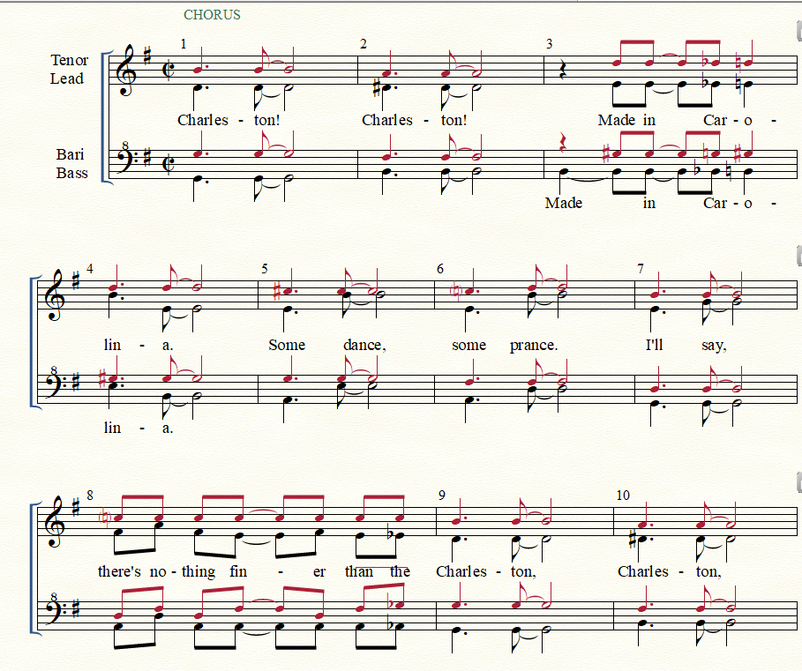

Slide 12
Intermediate Level
Consists of a small collaborative group with CMA/MMA facilitators, using online meeting technology.
A practical module with arrangement analysis assignments and hands-on arranging.
Managed by the SAI ACP Committee
Completion of the beginner fundamentals is a prerequisite, but a “challenge” has been designed for those wishing to bypass the beginner level.
Participants who successfully complete the Intermediate level will earn the title of Approved Arranger.

Slide 13
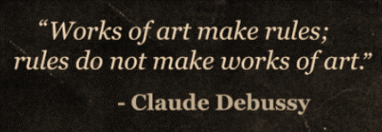

Slide 14
Advanced Level
A limited number of Scholarships to the Advanced Level are available from SAI to qualified individuals.
The application process requires the applicant to submit three arrangements completed solely by the applicant with no outside help. These are evaluated by a committee of SAI CMA/MMAs based on specific criteria which assess the knowledge and abilities of the applicant.
One-on-one mentoring will be provided by a CMA or MMA.
Candidates will have the opportunity to apply for advancement to CMA status upon successful completion of their scholarship.

Slide 15
Director Certification Program (DCP)
educational program
develop skills for SAI:
directors
potential directors
musical leaders
The program provides opportunities to validate the skills and knowledge required to direct a Sweet Adelines chorus.

Slide 16
The DCP is a self-paced program.
There is no specified time to complete the program.
It is beneficial to work with a chorus to get experience.
Sample tests are provided.
Support for each skill area is available through your DC and/or DCPC.
Completing the DCP provides a credential to validate the skills of those who meet the requirements.
Consists of 10 skill areas.

Slide 17
Skill Area 1 Directing Skills
Skill Area 2 Analytical Listening
Skill Area 3 Organizational Knowledge & Director Resources
Skill Area 4 Teaching Skills
Skill Area 5 Management Skills
Skill Area 6 Judging Categories and Competition
Skill Area 7 Vocal Production
Skill Area 8 Communication Skills
Skill Area 9 Music Theory (reciprocal with the ACP)
Skill Area 10 Rehearsal Planning and Implementation

Slide 19
Skill Areas
The 10 skill areas do NOT need to be taken in sequence.
The skill areas are evaluated in sections:
musical/technical skill areas and
management/communication skill areas
Both types of skills are needed to be an effective director.
Musical/Technical Skills
• Directing
• Analytical Listening
• Judging Categories & Competition
• Vocal Production
• Music Theory
• Rehearsal Planning & Implementation
Management/Communication Skills
• Organizational Knowledge & Director Resources
• Teaching
• Management
• Communication

Slide 21
Q & A

