Slide 1
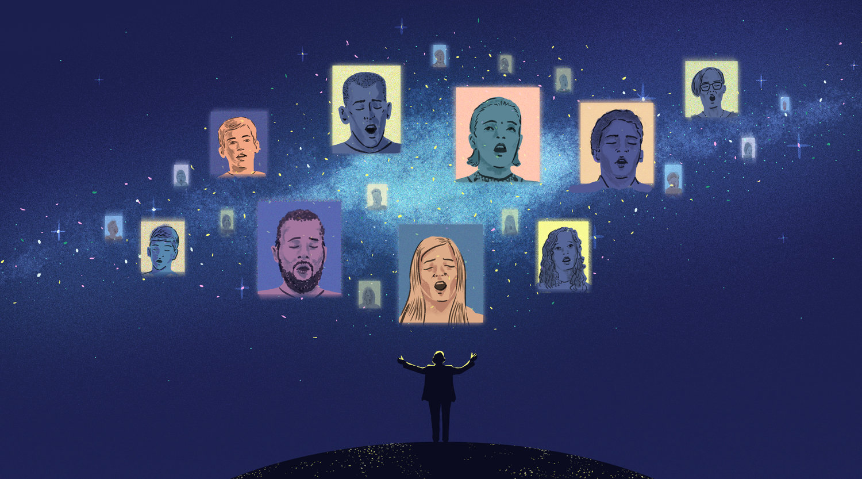
SECTION LEADER TRAINING
….IN THE WEIRDEST OF TIMES
Mary Rhea Region 15
International Faculty Vocalfest
Certified Sound Judge September 2020

Slide 2
Why do we continue to rehearse?
Stay connected
Something to look forward to – hope!
Prepare for in person rehearsals
Maintain sense of community
SECTION LEADER TRAINING

Slide 3
What CAN’T WE DO?
Hear the sound of singing together
Replace what we do live
Replicate what it feels like to sing together

Slide 4
What CAN we do?
Take some of the load from the director
Learn music
notes
interp plan
vowel sounds
breath marks
Learn vocal techniques
PVIs
Great warmups
Encourage vocal development
Motivational moments
Planning/goal setting
Music theory
Visual skills
Learn choreo
Explore facial expressions

Slide 5
Eat your vegetables – Vocalize daily!
They’re good for you
Commit to daily vocal work
Encourage singers to sing!
Doesn’t have to be complex

Slide 6
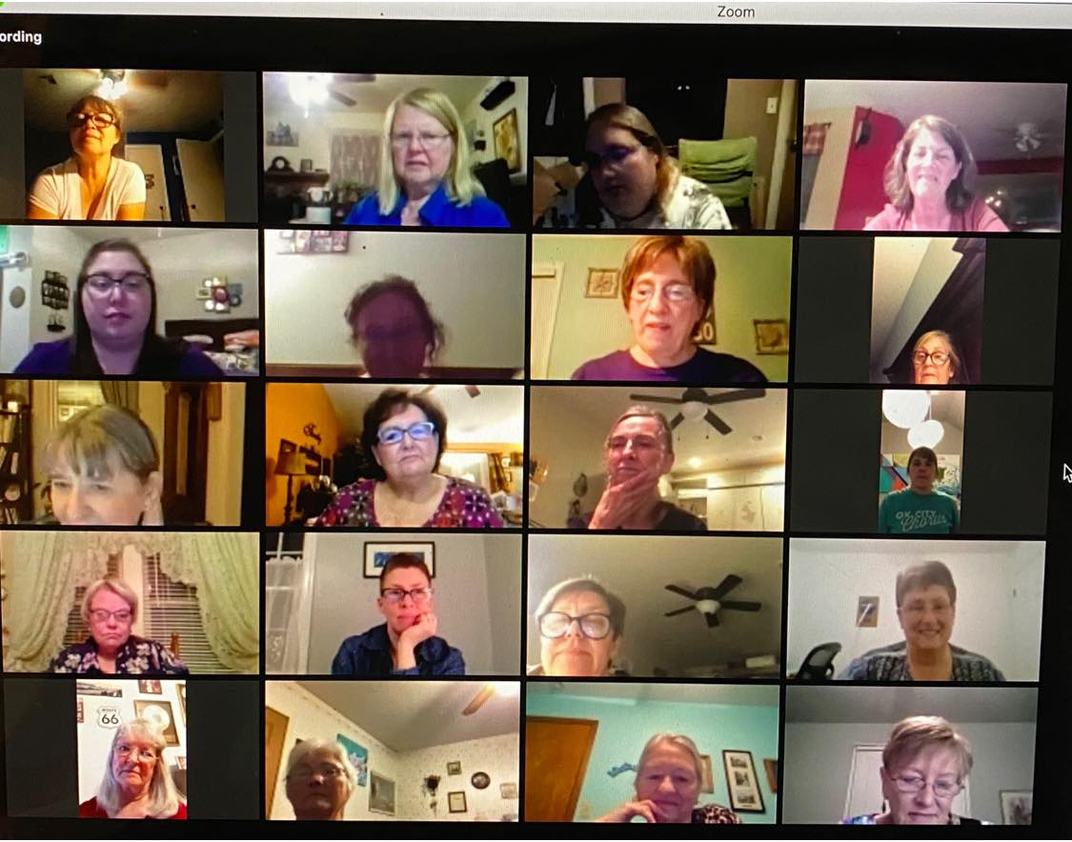
Specifics of running a rehearsal
Zoom platform
Know how to use it
Easier to use a laptop
Breakout rooms
Share screen
Share sound

Slide 8
Notes:
For better sound:
- Share computer sound
For even better sound:
- Advanced – Music or Computer Sound Only
- Can play music without “sharing screen”

Slide 10
Using recordings for rehearsal
Mark times on your music so you can start and stop in specific places
Helps rehearsal run smoother
Enables rehearsing sections of songs
Notes:
Mark times on your music if using a recording when you rehearse. That way, you can start and stop in specific places without having to hunt around for starting places.

Slide 11
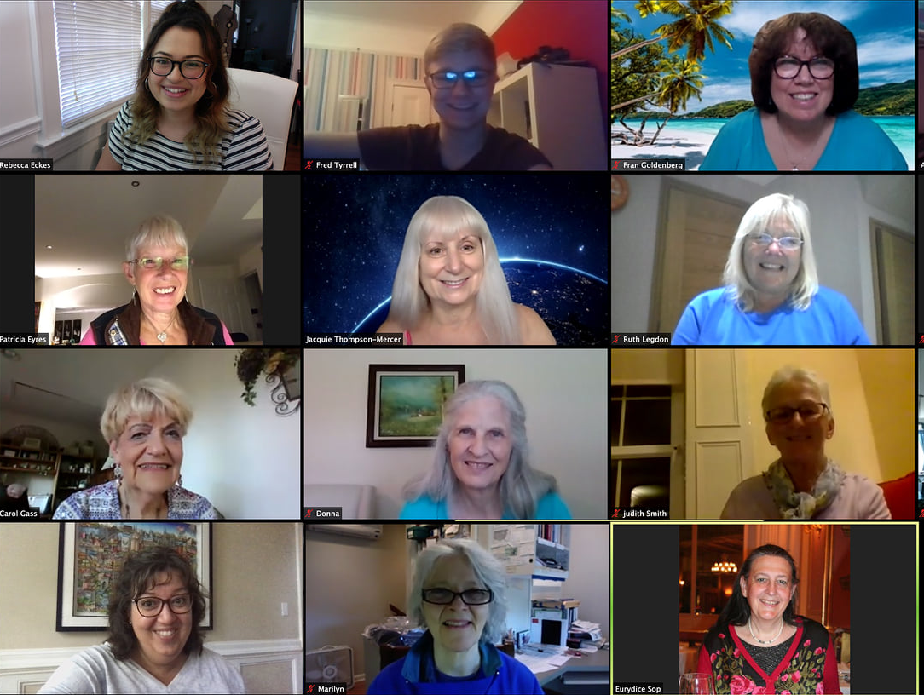
How Many Ways Can you Sing your Part?
Sing with full mix
Sing with the other three part predominant
Sing with section leader
Each person sing alone with or without recording

Slide 12
Musical Scavenger Hunt
Learn about a song you’re singing
Use the information in section rehearsals
Vowel sounds
Pronouns
Musical relationships
Teamwork
History of the song

Slide 13
Music connects us

Slide 14
And brings us together!

