Slide 1
FORWARD MOTION
Mary Rhea Vocalfest
International Faculty Region 15
Certified Sound Judge September 2020
Notes:
How many of you have seen comments about FORWARD MOTION on your scoresheets? It’s something we talk about, and we have a notion about what it is, but it’s obvious that we don’t have it mastered. That’s in large part because we don’t understand how to get forward motion.

Slide 2
FORWARD MOTION
Creating anticipation for what’s coming next
The sense that whatever is happening at this very moment in a song will need some kind of response of resolution
Notes:
How would you describe forward motion? Ask for suggestions in the chat.

Slide 3
FORWARD MOTION
The secret to musical vitality
Creates excitement
Relates to stress and release
Keeps listener engaged
All songs need forward motion
Notes:
Why do we need Forward Motion?

Slide 4
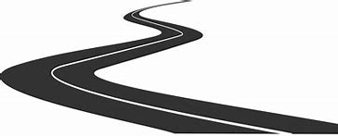
FORWARD MOTION ≠ SPEED
It’s not how FAST you get there - it’s the path you take to get there.
Forward motion does not mean a fast tempo.
Notes:
What ISN’T forward motion?
It’s not a fast tempo. It’s not speed. We sometimes confuse the two. It’s not about the tempo. It’s about the movement of the music.

Slide 5
Types of FORWARD MOTION
Musical
Harmonic
Melodic
Rhythmic
Lyrical
Physical
Emotional
Notes:
When researching the subject of Forward Motion, it was interesting to see that many musical genres made some mention of the concept. Instrumental music and different vocal styles talk about forward motion.
There are different ways to achieve forward motion. Really, all of them contribute. We need to have an awareness of all of the ways to achieve forward motion. If we only focus on one, the chances of achieving forward motion are slim.

Slide 6
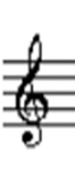
HARMONIC FORWARD MOTION
Notes:
Let’s talk first about Harmonic forward motion. On a jazz guitar website, they highlighted how the music itself creates forward motion. This is how instrumental music can create forward motion. The chord structure or the melodic line itself leads somewhere. It has destination. The overall destination is to DO – the tonal center.
In the melodic line, we have leading tones. The 7th is a leading tone – it leads to the tonic.
It creates tension that pushes the tune forward
There isn’t a lot we can do about the chord structure. That’s inherent in the song, and it’s the arranger who manages that. But we need to have an awareness so that we can take advantage of the chords and what they mean.
EXAMPLE: ii ->V sequence leads to anticipation of the tonic chord: I
TIME AFTER TIME – end of song
chords in bbs style = chords lead to TONIC
Tonic chord is found more often in a chorus. Verses tend to avoid the tonic chord – the verse leads to the chorus.
Verses usually describe; choruses are emotional. Don’t be overly emotional in the verse – it kills a song. You’ve already had your emotional response before you get to the chorus.
Melody often avoids the tonic note.

Slide 7
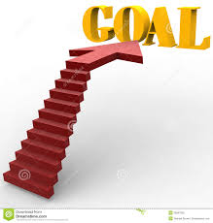
MELODIC FORWARD MOTION
Know where the melody is going
Find the anchor points
Notes:
Melodic forward motion is another type of musical forward motion.

Slide 8
RYHTHMIC FORWARD MOTION
The night ______ is like a love-ly tune. Be - ware, _____ my foolish
heart. How bright ______the e-ver constant moon. Take care, ____ my foolish
heart.
Notes:
Another way to think about forward motion is in the timing and rhythm of a song. Again, instrumentalists talk about this.
EXAMPLE:
Steer the shorter notes to the longer ones which happen to fall in the anchor spots. Imagine playing a violin. They lean into some notes, and flow through others. But there is still an implied meter in the song.
A melodic line sounds weak when rhythmic and melodic tension and release patterns are not congruent.
EX: sing the song with weird timing to demonstrate that the rhythm and the melody need to work together.
USE THAT’S WHAT FRIENDS ARE FOR TO DEMONSTRATE FLUID RHYTHMIC PATTERNS.

Slide 9
Notes:
https://www.youtube.com/watch?v=W0UrRWyIZ74
Listen how he gives just a little bit of hesitation. It almost makes you hold your breath until he strikes the next note. And then there is movement when the song begins to change. He creates that little bit of tension and then gives the release. It pulls us in and keeps our attention.
Claudio Arrau was a Chilean pianist known for his interpretations of a vast repertoire spanning the baroque to 20th-century composers, especially Bach, Beethoven, Schubert, Chopin, Schumann, Liszt and Brahms. He is widely considered one of the greatest pianists of the twentieth century.

Slide 10
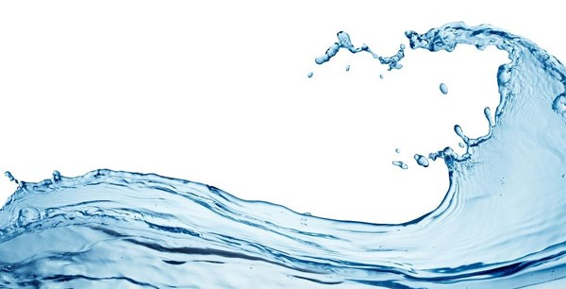
MUSICAL PHRASING
Every phrase has shape to it
Rise, fall, direction
Not speed, but how you shape a piece of music
Connection of the phrases
Ebb and flow within phrases
Ebb and flow within the song as a whole
Notes:
If we follow the natural rhythmic patterns and melodic patterns, the phrasing pretty much handles itself. There is ebb and flow in each of the phrases as it leads to the next thought.
Phrasing is a combination of the musical elements and the rhythmic elements. In some songs, it just makes sense. The composer and the arranger take care of these things.
Let the music flow. It helps us to know what creates the tension and what causes the release so we can take advantage of those elements.
Throughout the chorus, there is ebb and flow as it leads to the verse.

Slide 11
LYRICAL FORWARD MOTION
Tell the story
ASK questions
Conversational delivery
Use word sounds as transportation
Notes:
There is another key element to songs that we perform, and that’s the lyrics. The lyrics tell a huge part of the story. But the music tells a story, too. There has to be an awareness of both the musical elements and the lyrical elements to create the story. We can’t do one or the other. We need both.

Slide 12
LYRICAL FORWARD MOTION
And I
(I what?) never thought I’d feel this way
(How are you feeling?)And as far as I’m concerned I’m glad I got the chance to say
(Say what?)That I do believe I love you
(Tell me more!) And if
(If what?) I should ever go away
(What would happen?) Well, then close your eyes and try to feel the way we do today
(What should I do?) And then if you can remember
Notes:
Let’s take a look at That’s What Friends are For.
Ask questions while you’re singing, and then respond to those questions.
When you ask the question at the beginning of the sentence, it doesn’t connect the next thought.

Slide 13
LYRICAL FORWARD MOTION
And I (I what?)
never thought I’d feel this way(What are you feeling?)
And as far as I’m concerned I’m glad I got the chance to say (Say what?)
That I do believe I love you (tell me more!)
And if (if what?)
I should ever go away (What would happen?)
Well, then close your eyes and try to feel the way we do today(What should I do?)
And then if you can remember (remember what?)
Notes:
Now let’s flip WHEN we ask the question. Let’s sing the same section with these questions in mind at the END of the phrase. While you’re singing the last of the phrase, you begin to think about the next phrase.
Jenny Morton talked about the fact that it takes our brains a minute to catch up to what we’re seeing and hearing. If we TAKE the audience on the journey with us, they will be more connected to the message. They’ll understand the transition better because they have more time to process it. It allows the audience to feel more sooner.
What difference does it make? Does it carry you into the next phrase?

Slide 14
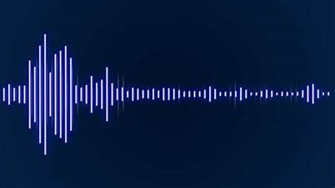
DYNAMICS
Create emotional response
Offer tension and release opportunities
Use of textures enhances dynamics
Should work hand in hand with melody highs and lows
Notes:
We can also use dynamics to create an emotional response. Think of Ravel’s Bolero. The tempo stays consistent, but the dynamic level builds. As the dynamic level builds, you can feel the excitement. The texture of the music changes.

Slide 15
Notes:
https://www.youtube.com/watch?v=GJVWEstu_lM

Slide 16
PHYSICAL FORWARD MOTION
Feel the sweep of the music
Do gestures on purpose
Eyes – take the audience where you want them to go by changing your eye focus
Physical energy
Keep body alert and involved
Notes:
Physical energy
Don’t let body collapse at the end of every phrase. Lift the body to let the audience know that there’s more coming.
Use eye contact or focus to set the stage for the audience.

Slide 17
FORWARD MOTION Vitality Anticipation Engagement The best is yet to come!
Notes:
Forward motion – it’s something that we need in every song we sing. It adds vitality and life to our performances. It creates anticipation. It engages the audience and lets them know that we might be doing something great right now, but the best is yet to come!

