Slide 1
Greater New York / New Jersey Region 15
MEMBER OF NOTE 2023
Announced and presented at VocalFest 2023 in Parsippany, NJ

Slide 2
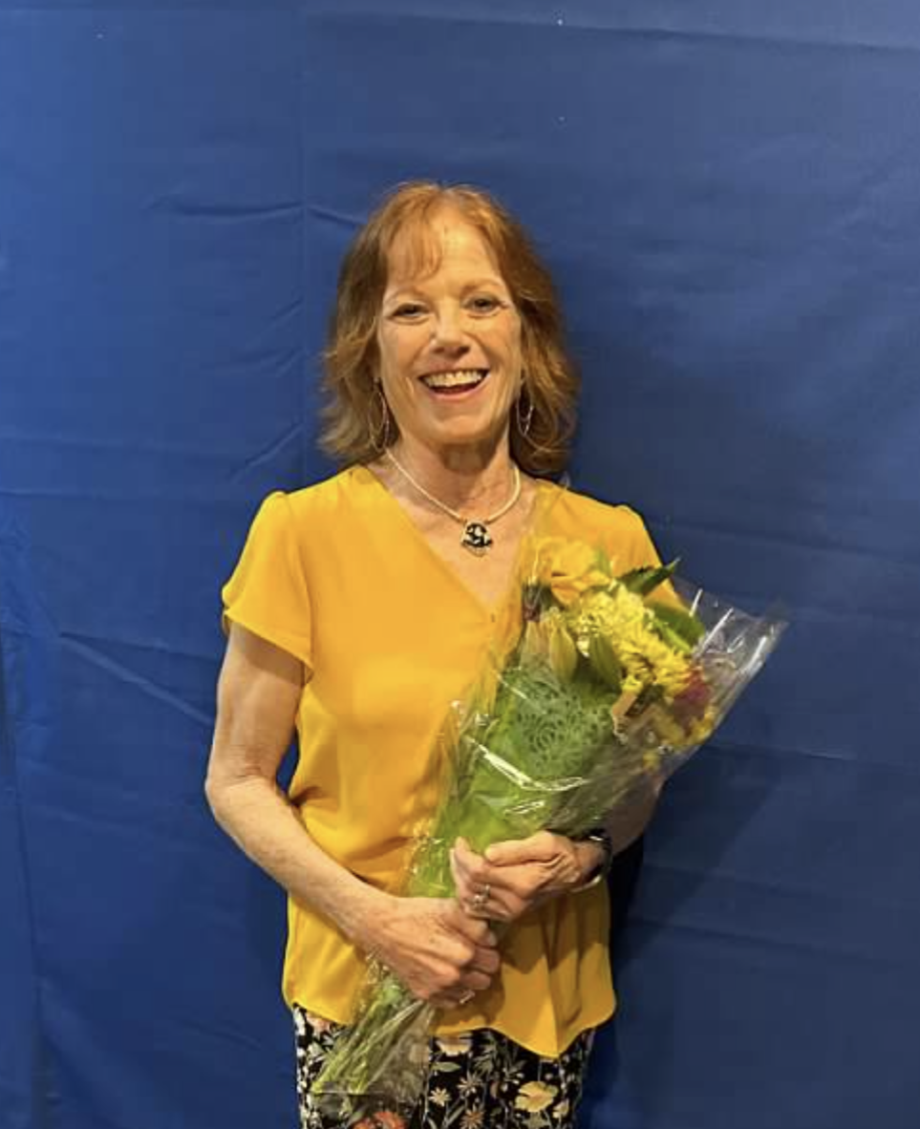
Mary Murphy Capitaland Chorus
Capitaland Chorus is proud to name Mary Murphy as our 2023 Member of Note!
We are so lucky to have Mary in our chorus, she’s kind, caring, hilarious, creative and dedicated. A baritone who can be counted on to learn her music quickly, she will also help others in her section whenever they ask. She has sung at nearly every paid performance for the last 10+ years, rarely misses a rehearsal or coaching session, and has performed in the front row for years as well as her quartet Now & Then.
Mary serves on Management Team, where she has been active for multiple terms over time, and on the Costume Committee. She has recently taken over email communications for the chorus, she manages our can donation program, and she is a current & past Big Sister. Whenever there’s a project to be done, Mary is almost certain to be involved, whether it means a lot of work in a short time or a constant steady effort throughout the year.
Mary is a bright light who sparkles AND casts a steady glow, she brings a marvelous warmth to both our sound and our lives!
Congratulations, Mary!

Slide 3
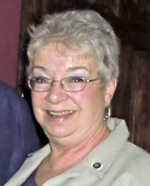
Jan McGrath City of The Hills Chorus
Music has been part of Jan's life for many years. She was in chorus in high school, participated in college musicals and is in the choir at her church. In 1993, after she heard a performance of City of The Hills Chorus in her town of Cooperstown, NY, Jan said she could not wait to be part of its beautiful harmony. Jan became an official member in 1994.
In the early years of her membership, Jan's young son would come to rehearsals with her and play quietly during the evening. At home he would pick up the lead part for songs Jan was learning and sing while she quietly dueted the Bari part with him. That young son now is father of 4 children who love to put on "shows" for Grandma Jan and her husband.
Little did Jan realize in 1994 how dedicated she would become to the Chorus. She's now in the Bass section, our Assistant Director, the chorus' Historian, and, for several years, President of our Board of Directors. She has been a member of three quartets, and currently a member of Four of Hearts quartet.
Jan is now retired after completing 46 years in Human Resources at M.I. Bassett Hospital in Cooperstown. Jan's church plays a very important part of her life, as she is the Church's Treasurer, a member of the Church Council and of course a member of the choir. When asked about Chorus adventures, she replied “Well, I broke a tooth on a tuna sandwich in Syracuse at Competition, several singing sisters accompanied me on foot looking for an emergency dentist - and we found one”.
We all love Jan; she is very encouraging when she steps in as director. She is a natural leader. We are all pleased to be able to honor her for her many years of hard work by selecting her as 2023 Woman of Note.
Congratulations, Jan!

Slide 4
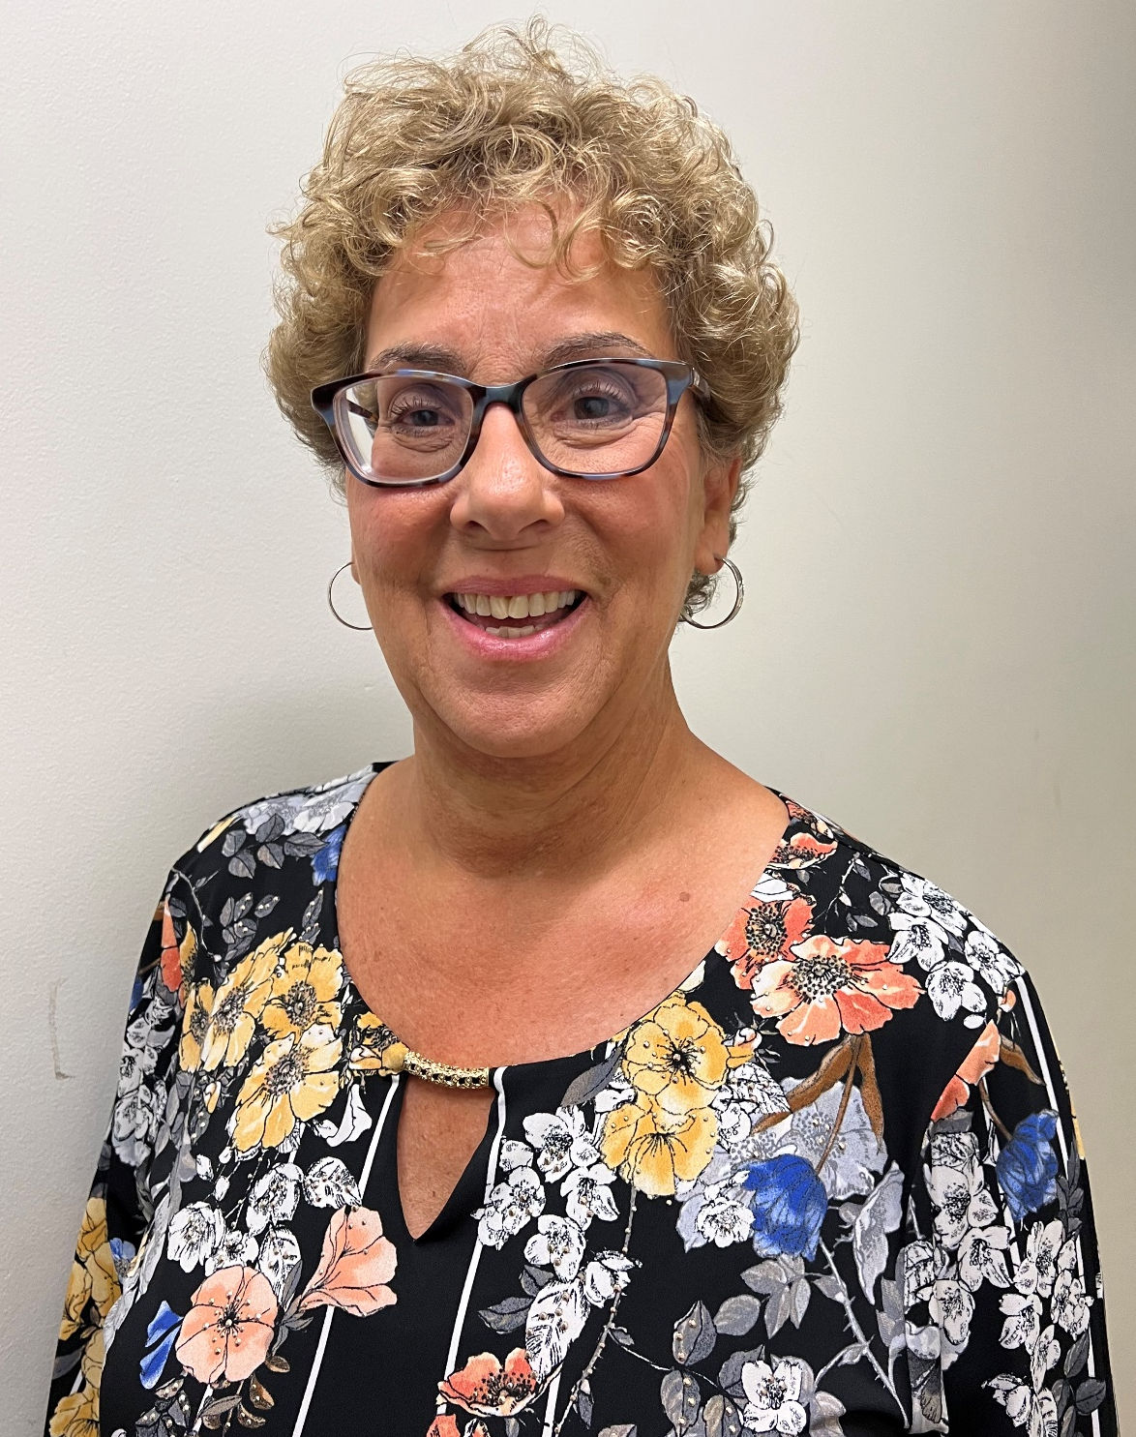
Carole Argulewicz Evergreen Chorus
Evergreen Chorus is pleased to announce Carole Argulewicz as our 2023 Member of Note. Carole Argulewicz is the quintessential Sweet Adeline and has been so for over 40 years with Evergreen! Throughout her 25 years of directing Evergreen, she continually finds creative ways to motivate, educate and expand our barbershop community.
She used her resourcefulness to keep the chorus engaged throughout 2 years of Zoom rehearsals by providing music theory lessons, bringing in SAI guest speakers/singers, organizing virtual open houses, and suggesting activities for each member to be personally involved. Carole’s infectious positivity, inclusivity, and passion for barbershop permeates throughout the chorus. She encourages others, sees their hidden talents, and guides them to try new things, which has cultivated our trust in her as a director, musical educator, and leader. She gives of her time and musical talents unconditionally, offering countless PVIs and extra classes, along with coaching for many choruses and quartets. She continually strives to have every SAI member sing their best.
As a member of the Management Team, she makes valuable suggestions, collaborates with the Team to develop innovative approaches, and supports each Team member in executing their responsibilities. Carole has a wonderful relationship with our Regional and International leaders. She has served multiple terms as Director Coordinator on the RMT, provided regional education sessions, and continues to volunteer within the region. She shares her ideas and tips with other choruses, and shares what she has learned from others with Evergreen and the Region. Carole is the ultimate SAI role model for our aspiring leaders. One of Carole’s fondest memories of Sweet Adelines is her 2001 first place in Region 15 with her quartet, Xclamation!, and then competing at International in Portland. In addition, she was thrilled to take Evergreen to the 2017 Harmony Classic, with a terrific third place finish. As Carole returns to singing on the risers in 2024, we are looking forward to her singing with Evergreen and hearing more from Impact, her new quartet!
Congratulations, Carole!

Slide 5
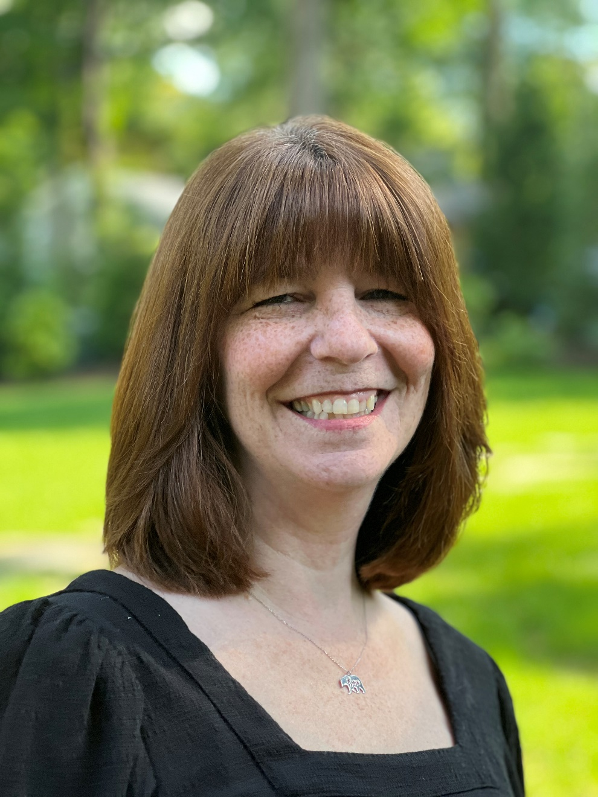
Kim Gooding Greater Nassau Chorus
Kim has been a Sweet Adeline for 18 years and is an A+ member of GNC at every level. Kim works tirelessly as a devoted member of the music team. She is the sole Lead section leader and goes above and beyond by developing musical programs for the chorus as a whole. She offers musical advice to any member when needed, often arriving early or staying late on rehearsal nights to provide support. She gives her time for private meetups on zoom or to assist with fun quartets and auditions.
As the Lead Section Leader, Kim has a huge responsibility. She meticulously reviews and models each song according to Harriette's interpretation and proactively works with the section to own it. She conducts outside rehearsals, maintains structured taping expectations, and communicates with her tape coaches. She meets every singer's needs individually and gives kind encouragement. Her leadership has helped the Lead section soar to new heights.
Kim has been involved in many chorus aspects over the years. She held the position of Membership Co-Coordinator on the Management Team. It’s no surprise that she excelled in this role – helping newcomers feel comfortable and guiding them in the GNC values and process. Kim’s leadership style, willingness to help any section or individual, along
with her kind nature has led to Harriette to ask Kim to be a member of her Director Coordinator Regional team.
Outside of chorus, Kim is wife to Gordon and mom to daughters Alison and Lauren. She also has been an important part of niece Alicia’s life – helping to guide and mentor her. Together, her and her husband own Gooding Wellness Group – providing mental health services and therapy to those in need. Kim manages many aspects of the business.
Kim exemplifies what it means to be a Sweet Adeline. Her dedication and positive influence - in and out of chorus - makes her the perfect choice for Greater Nassau Chorus’ 2023 Member of Note.
Congratulations, Kim!

Slide 6
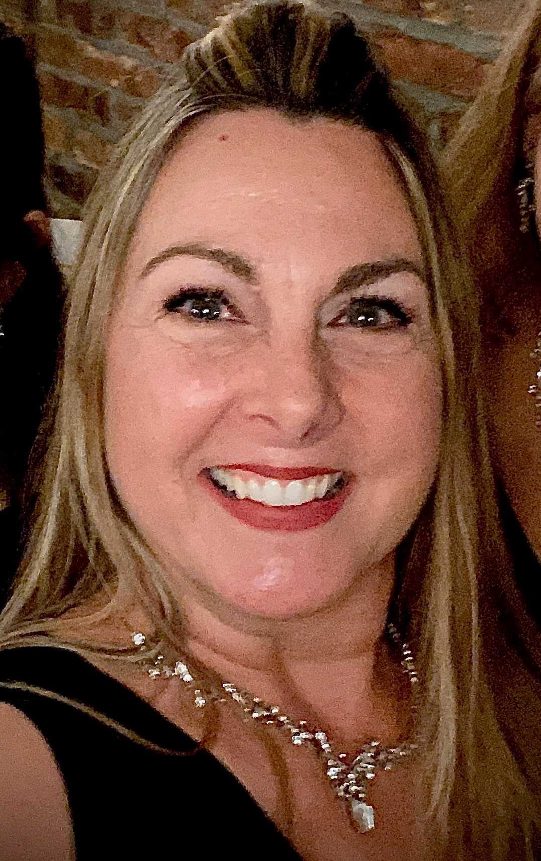
Georgette Chrystal Harmony Celebration Chorus
Georgette Chrystal: A Shining Example of Love and Leadership
Georgette Chrystal has been Harmony Celebration Chorus’s baritone section leader for over a decade, consistently demonstrating her dedication to helping her section both individually and as a unit. As Team Co-Coordinator in recent years, Georgette has led the chorus through unprecedented times and her recognition is long overdue! She has wonderful leadership skills, a kind demeanor, and an amazing ability to help those around her feel comfortable, even in difficult circumstances. Georgette works to make people feel included and valued, reaching out to include newer members and finding ways to recognize longer standing members with Emeritus Membership and Retirement Celebrations.
She brings great ideas to lead the chorus, creating a job fair and bringing us back to our core values with the HCC motto – HCC Better Together! Georgette’s many contributions cannot be overstated. She always takes time to get involved and handle chorus matters, while maintaining a positive attitude. Invariably, she comes prepared and makes sure she's on top of chorus needs, both as a member and a leader, serving as a clear role model. Georgette is thoughtful, genuine, and is the perfect representation for this chapter both at the regional and international level. She guides the chorus forward in a positive direction, to focus on the energy and excitement of our most recent international placement. Ultimately, Georgette serves to remind us of the possibilities of our future - HCC Better Together!
Congratulations, Georgette!

Slide 7
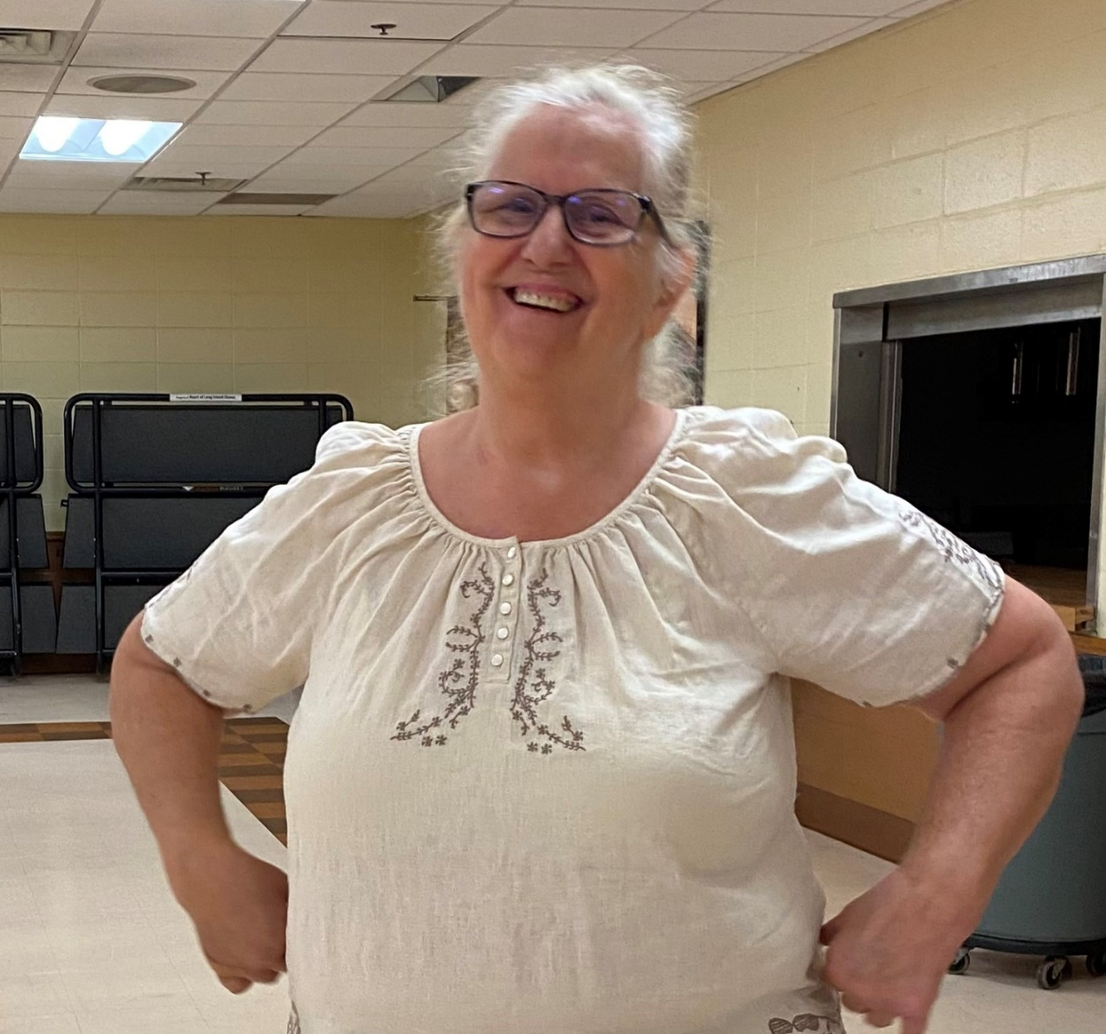
Deanna Wade Heart of Long Island Chorus
What can we say about our sweet, lovely Deanna?
Deanna has been beautifully singing Baritone in our chorus for the past 7 years. She is our Treasurer and meticulously maintains our financial health. Not only that, Deanna runs our Sunshine Club where every birthday and major life event of our members is commemorated. Our Deanna has also run some fundraisers for us, from beginning to end. She always says yes when something has to be done, even if it’s not related to finances. Her dependability and flexibility goes a long way!
Deanna, we are so grateful to have you as an exemplary member of our chorus! CONGRATULATIONS DEANNA!!!!"
Congratulations, Deanna!

Slide 8
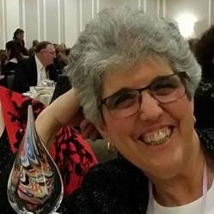
Jeanne Elmuccio Heart of New Jersey Chorus
Jeanne works tirelessly on behalf of the chorus, showing care for members as individuals, as well as the chorus as a whole. She brings enthusiasm, fun and an unwaveringly positive attitude to all that she does and it is contagious!
Jeanne has a knack for making every rehearsal a wonderful and fun experience. She dedicates so much of her time and effort to teaching us, and bringing us to our fullest potential as singers. She continuously strives to help us learn, all while making it so much fun! She works effortlessly to make us the best we can be. Her love of music and the organization is infectious. Jeanne is truly the “heart” of this chorus. She not only directs us, but she arranges music for us to perform. If we run into a problem with an arrangement, Jeanne can fix it.
During the pandemic, our Zoom rehearsals were always interesting and fun. We not only learned several new songs, but Jeanne also made videos that we were able to share. She kept us all connected…….and that meant so much to us. We are so incredibly fortunate to have Jeanne at the helm.
Our fondest wish is to make her proud of us……….we are so proud of her! She is an ambassador of the highest caliber for the organization. Congratulations, Jeanne. You are so deserving of this award.
Congratulations, Jeanne!

Slide 9
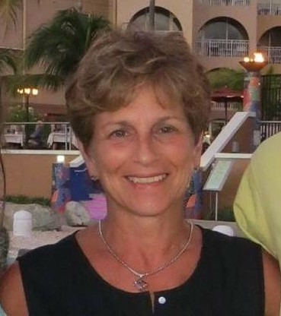
Nina Comanto Hickory Tree Chorus
Nina Comanto is one of the most devoted and loyal Sweet Adelines we know. She is constantly touting how much Hickory Tree Chorus and SAI means to her and she gives it right back to us.
She joined SAI in 2009 and Hickory Tree in 2015. She comes by her love for barbershop honestly as her father Sam was a barbershop singer for more than twenty years!
Nina almost immediately joined the management team, serving as our fabulous feisty fund raiser and head of the Ways and Means Committee. With her attention to detail (just ask members how many emails it takes for her to communicate all the nuances to pull off a successful garage sale or craft fair), she has helped us raise thousands of dollars each year since 2016!
Nina is a valued member of our baritone section and is a vibrant performer on our front row! She has also competed in 2 quartets in her tenure with HTC, attaining higher scores each time she's out there. Nina takes advantage of every opportunity to improve her singing, rarely missing a rehearsal or VocalFest and attends the International competition and IES as often as possible.
With her Brooklyn New Yawk accent and great enthusiasm for our chorus and all things Sweet Adelines, Nina is a treasured member of Hickory Tree and Sweet Adelines and we are proud to name her as our 2023 Member of Note.
Congratulations, Nina!

Slide 10
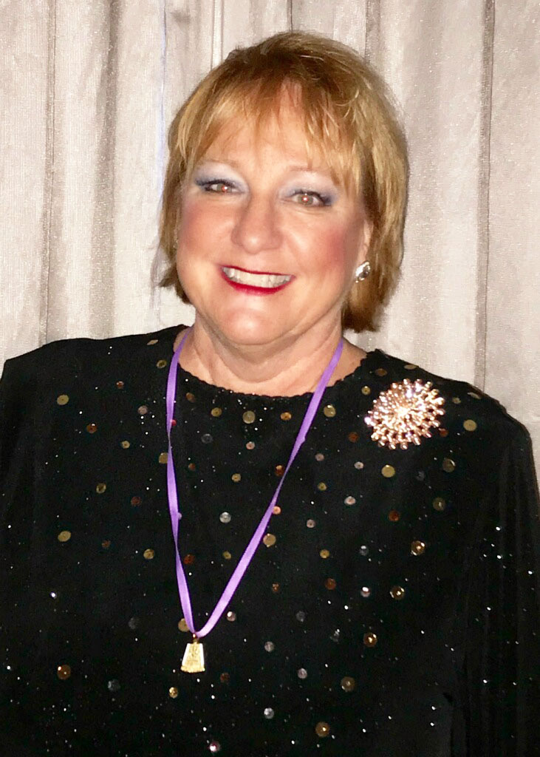
Deborah Rode Island Hills Chorus
Singing alongside so many amazing Island Hills Members highlights this honor. It was by a purposeful accident that I found Island Hills Chorus in 2016. I finally found a way to pair my love of singing with structure. Not having sung with a group since high school, my section leaders helped me to hone the craft and the desire to stay. My first Regional competition was exciting, challenging and filled with camaraderie. The costumes and choreo were new to me and I wasn’t sure I could last, but I stayed for the friendships I made and discovered personal tenacity.
VocalFest only added to my confidence. Supporting the Island Hills chorus as Chorus Events Coordinator, Team Leader and as Treasurer was fun work! Whether driving a 26-ft truck for a garage sale, hauling and setting up risers, and coordinating a trip to the U.N. or securing retreat sites, I wanted the chorus to succeed!
Humor is always the best tool! My degree in Business Management and a career in accounting have allowed me to share those skills outside of the office with the management team and our committees. My husband Charlie and my three sons have been supportive and happy for my journey. In addition to singing I enjoy cooking, being Mrs. Fix-it and weekend trips. It’s the little things that we ALL do to make it work. Yet nothing is little about this nomination, nor is the pride I feel to be an Island Hills Chorus member.
Congratulations, Deborah!

Slide 11
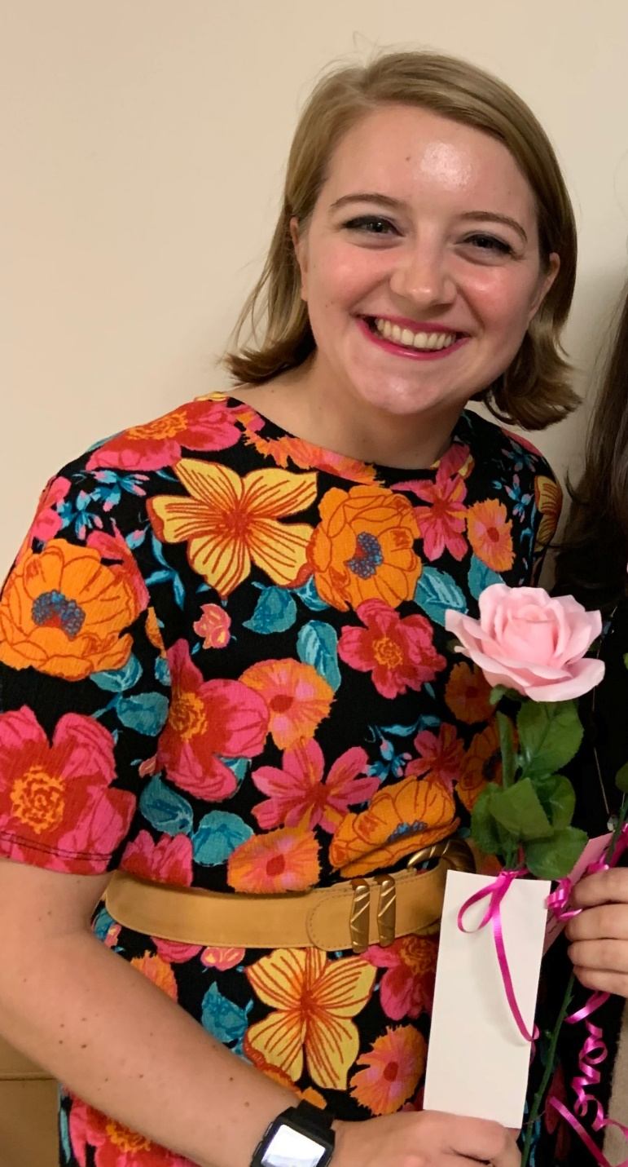
Laura Transue Jersey Harmony Chorus
Jersey Harmony’s choice for this year’s Member of Note is our sweet and talented tenor, Laura.
She has been a member since 2019. Laura lives in Monmouth Junction and is a Student Engagement Manager and Senior Media Specialist at Rutgers University. Besides her love of singing, Laura plays piano and is an advocate for creating a cleaner and healthier environment.
Our young tenor shares her lovely smile and appealing sound with us each week. Despite her busy schedule, Laura adds her talents to many areas of chorus activities and duties, including performance engagements, media, and helping with audition and practice quartets.
We love having this pleasant, intelligent, and talented young lady with us as a member of Jersey Harmony.
Congratulations, Laura!

Slide 12
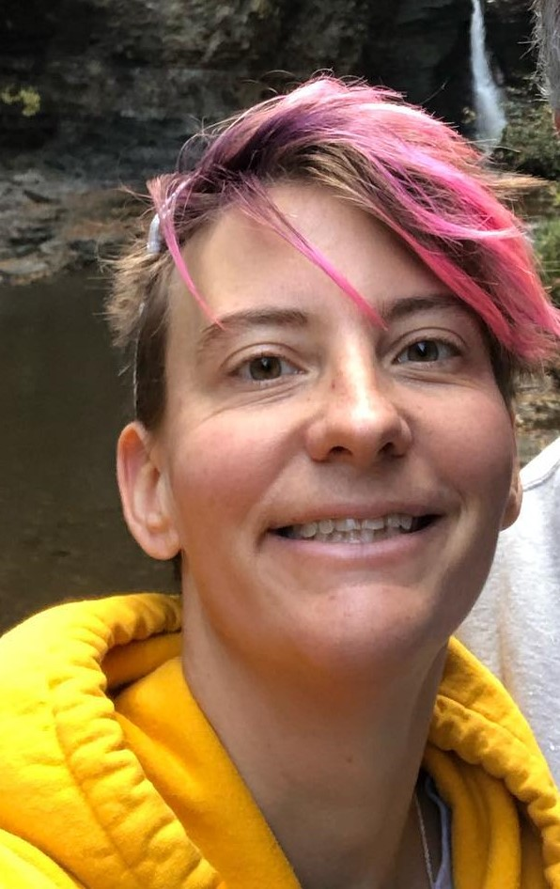
Laura Reagan Liberty Oak Chorus
The Liberty Oak Chorus Member of Note for 2023 is Laura “Ducky” Reagan! Ducky joined the chorus five years ago, and during that time has become invaluable, working behind the scenes on all things tech as well as being a wonderful part of our Lead section. She has made a name for herself over the years, earning recognition as “Most Improved Performer” one year and “Unsung Hero” another. Ducky travels from Pennsylvania every week in order to come to chorus, and is nearly always accompanied by her husband Terry, who introduced her to Barbershop music. She arrives early to help with setup of the sound system (and also has helped many times with riser setup) and has purchased equipment on her own when she sees a need. She always has the physical warm-up songs and current repertoire songs at the ready on her phone and synched to the sound system during rehearsal to save time and hassle, and also takes care of recording a video of rehearsal each week and uploading it to a private YouTube channel so we can review when needed.
During the period of time we could not rehearse in person due to COVID, Ducky helped a lot with making Zoom rehearsals functional. She is also incredibly humble, caring, and always with a positive attitude. She does not seek out attention, but when someone needs something, she is always there. She has hand-crocheted incredibly beautiful prayer shawls and other special items for members going through difficult times. Outside of chorus, Ducky works as an architectural designer, with a degree in computer-aided design. She has five children, two of whom are still young and living at home. She and her husband Terry enjoy hiking and fishing, and he has been a wonderful supporter of Liberty Oak as well! A true team player, Ducky always has a smile at the ready and is a wonderful ambassador for the chorus and for Sweet Adelines as a whole. You will recognize her because of her colorful topknot of hair, her interchangeable funky glasses frames, and mostly, because she absolutely loves singing Barbershop! We are proud to honor and recognize her in this way!
Congratulations, Laura!

Slide 13
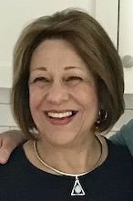
Evelyn Gillespie Long Island Sound Chorus
In February of 2021 our chorus got the terrible, shocking news that our dear friend and Finance Coordinator, Colleen Marron, passed away in her sleep after routine dental surgery. Without missing a payment or a beat, our Woman of Note, Evelyn Gillespie, stepped up to help. Ask anyone who has handled the job of chorus treasurer, it is not an easy task. Evelyn’s background as a college math major served her well as she sorted through the piles of random papers, time sensitive bills, checks, envelopes and business irregularities that had co-opted her entire dining room table. Our Membership Coordinator, Thea DiSunno quipped, “The moment I laid eyes on Evelyn, I knew she was a winner.” And so she is. Evelyn was able to analyze and revamp the entire chorus banking system on her own, without the support of a predecessor. She has created a well-oiled, functioning system that has kept the chorus solvent ever since she took over.
Evelyn has spearheaded the chorus’s generous charity efforts. Through her vision and guidance our chorus of thirty-eight members donated $1,600 to Mercy Chefs, a disaster and relief organization that provides professionally prepared, restaurant quality meals to victims, volunteers, and first responders aiding in natural disasters and emergencies around the world.
Music has always held an important place in Evelyn’s life. In her younger years there were piano lessons and frequent trips to the city to see the latest Broadway shows. At home, her mother cooked and cleaned to crooners, Frank Sinatra and Tony Bennet while her father showed off his Gene Kelly dance moves. Evelyn performed sacred Latin music and popular songs with the all -woman’s chorus at Rosemont College in Pennsylvania. It is no wonder that years later, when she moved to Hampton Bays after her family was raised, she found the Long Island Sound chorus to continue pursuing her love of singing. Her family includes her loving husband, three daughters, a son and eight grandchildren. We honor her as our 2023 Woman of Note!
Congratulations, Evelyn!

Slide 14
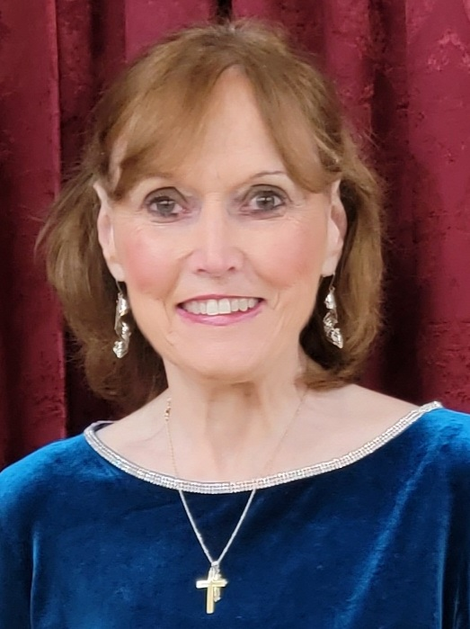
Victoria "Tori" Green Saratoga Soundtrack Chorus
Vicky Is our behind-the scenes gal extraordinaire. She has worked tirelessly to take care of all the paperwork for our Regional Contest and for Vocal Fest. She makes sure we have all the information we need and keeps track of our registrations, room assignments, and financial payments. She is very organized and makes sure we are all set with our paperwork enabling us to compete. She’s always available to answer questions and makes sure that the newbies are taken care of. This year, our chorus had front row seats at the regional dinner because Vicky was the first to turn in all our paperwork.
Vicky is also our coach liaison and chorus historian. She takes care of whatever our coaches may need when visiting our chorus for a coaching session and keeps track of the chorus history. During Covid, she took on the extra paperwork and responsibilities involved to keep our chorus as safe as they can be in a difficult time. She has served on our Management Team and was chorus secretary while serving on the team.
Her dedication to Saratoga Soundtrack is exemplary. We are proud to have Vicky as our Member of Note 2023.
Congratulations, Tori!

Slide 15
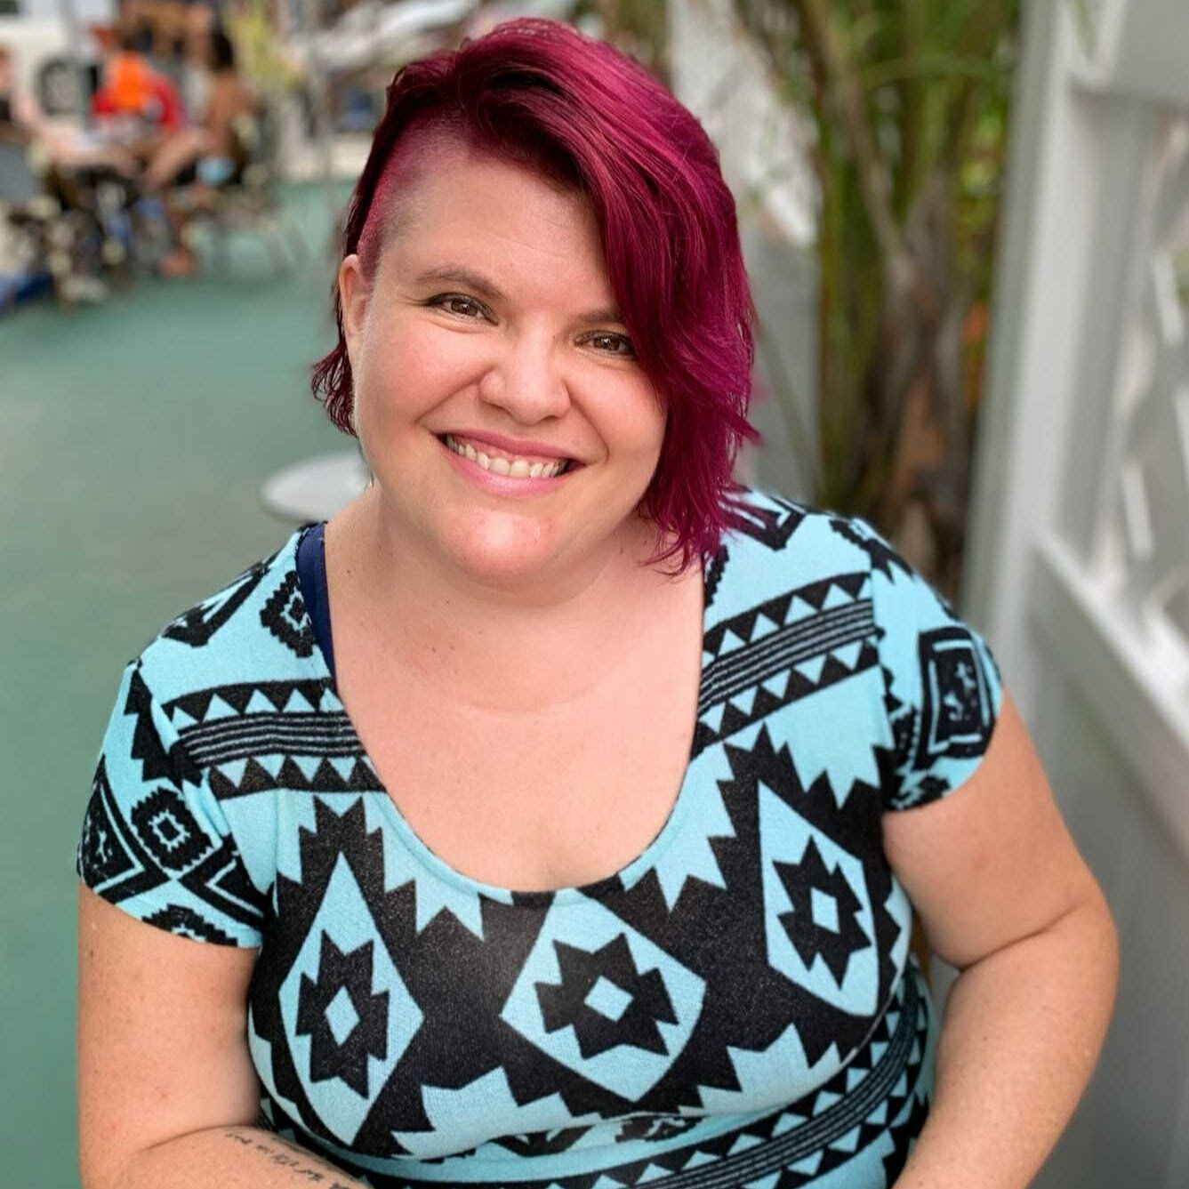
Colleen Christi Willett Sirens of Gotham Chorus
This year, our 2023 Member of Note is the delightful and multitalented Colleen Christi Willett for her outstanding contributions to the chorus! Colleen has been a driving force of dedication and positivity within the Sirens community for many years.
Since joining in July 2019, she's worn multiple hats and contributed significantly to the chorus's growth and cohesion. Colleen almost immediately started volunteering to assist the chorus even before her time on the board, like helping coordinate photography for a winter show and offering her professional catering services for receptions and events. Colleen remained dedicated to the chorus during the pandemic, proving essential in maintaining connections among members through virtual activities and personal outreach. Many of us still make the charred broccoli recipe she taught us during one of her multiple self-organized virtual cooking classes!
Colleen stepped onto the board in May of 2021 as Sirens’ VP of Membership, and embodied Sirens' welcoming spirit by providing guidance to newcomers and veterans alike. And, amidst recent unexpected leadership changes, Colleen fearlessly stepped up as President, showcasing her deep commitment to Sirens' well-being.
Colleen's journey as a singer is also remarkable! She actively invests in her growth as a vocalist, engaging in voice lessons and refining her skills, providing a shining example of Sirens’ core value of ambition. She has even switched from the bass section to baritone! Her quartet history started with “Totally Uncalled Four,” and her quartet “Off the Record” recently took home the 2023 M-AD Northern Division novice quartet award.
Colleen’s warmth, creativity and sense of humor are highlights of our weekly rehearsals and her leadership has been a huge asset to the chorus. We are so proud to honor her as this year’s Member of Note!
Congratulations, Colleen!

Slide 16
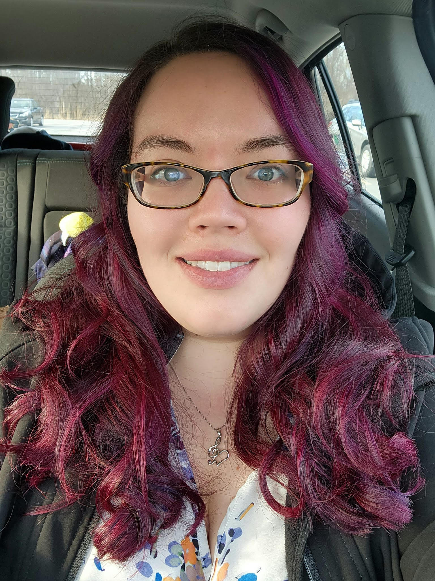
Karla Chun Spirit of Syracuse Chorus
The Spirit of Syracuse Chorus is happy to announce that Karla Chun as our 2023 Person of Note!
Karla joined the chorus in 2018 after being “forced” to attend our Regional Convention and has been hooked ever since. Her enthusiasm for the chorus and Sweet Adelines is infectious. It’s hard to walk away from a conversation with her without a smile on your face.
In 2021 after organizing multiple fundraisers and being a member of our Riser Committee, Karla agreed to join the management team as an Associate Member. In 2022 she became an official member of the Management Team as a Delegate at Large and very quickly transitioned into the role of Communication Coordination. Since taking on that role she has revitalized our social media presence, starting with the “Meet our Member” campaign that has been used by many other choruses around the region and the organization, to highlight the existing chorus membership.
She has also led several other initiatives on member recognition including reintroducing our birthday acknowledgements in a way only Karla could and creating other fun ways for members to interact outside of our normal rehearsals. Working with our membership team she helped develop the marketing campaign for our very successful membership drive and has developed media for multiple events including our 65th Anniversary Gala. Please join us in congratulating Karla!
Congratulations, Karla!

Slide 17
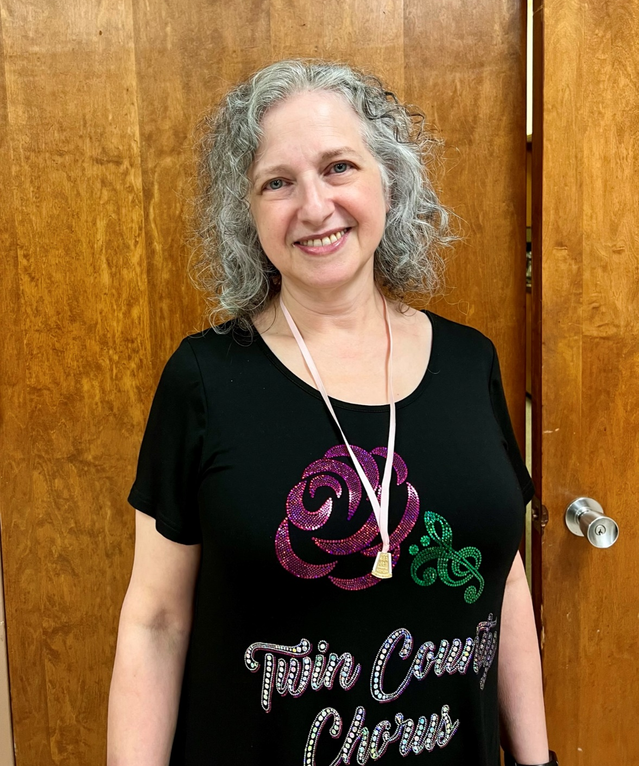
Deborah Lorber Twin County Chorus
With great joy and love, Twin County Chorus has unanimously chosen Deborah Lorber one of our Baritone singers, as Member of Note for 2023.
Deborah embodies the qualities we want for our Member of Note - someone who works cheerfully and tirelessly for her chapter. She volunteers to do many things, and when asked, she is always happy to help. Deborah belonged to another music group, where she met two Twin County members, Liz Levitt and Linda Linsenbarth, who encouraged her to join. When she came to her first rehearsal, she didn’t know what to expect and said she was blown away by the sound and the fun. She was chosen for the Bari part. She immediately wanted to help anyway she could. She helped our facilities coordinator, and worked very hard as we returned to rehearsals during the pandemic to make sure we followed guidelines about social distancing. She later served on our management team in the role of membership coordinator.
Music has always been an important part of Deborah’s life. She played piano, clarinet, and oboe in high school, and played in her school band. She’s been singing her whole life, and with Twin County Chorus for the past eleven years. When she was asked to fill in for one of our front-row dancers, she took on that role with confidence and style. Always with a sweet smile, always on time, always ready to help, Deborah has lovingly and generously shared her many talents with our chorus. She has helped the visual team with warmups and with costume choices. She helped with all our fundraising events, sold tickets to family and friends, and has directly and indirectly been responsible for welcoming new members.
Truly an extraordinary member of our chorus, Deborah is Twin County’s Member of Note for 2023.
Congratulations, Deborah!

Slide 18
Congratulations to all of our
Greater New York / New Jersey Region 15
MEMBERS OF NOTE 2023!

